Slide 1
Pre-France Committee Meeting
August 14, 2013

Slide 2
Dissertation Summary
Larval oyster response to ocean acidification
Juvenile oyster response to ocean acidification
  Proteome characterization
  Response to ocean acidification: proteomic, fatty acid, shell micromechanics
  France: in depth protein characterization
Extras!

Slide 3
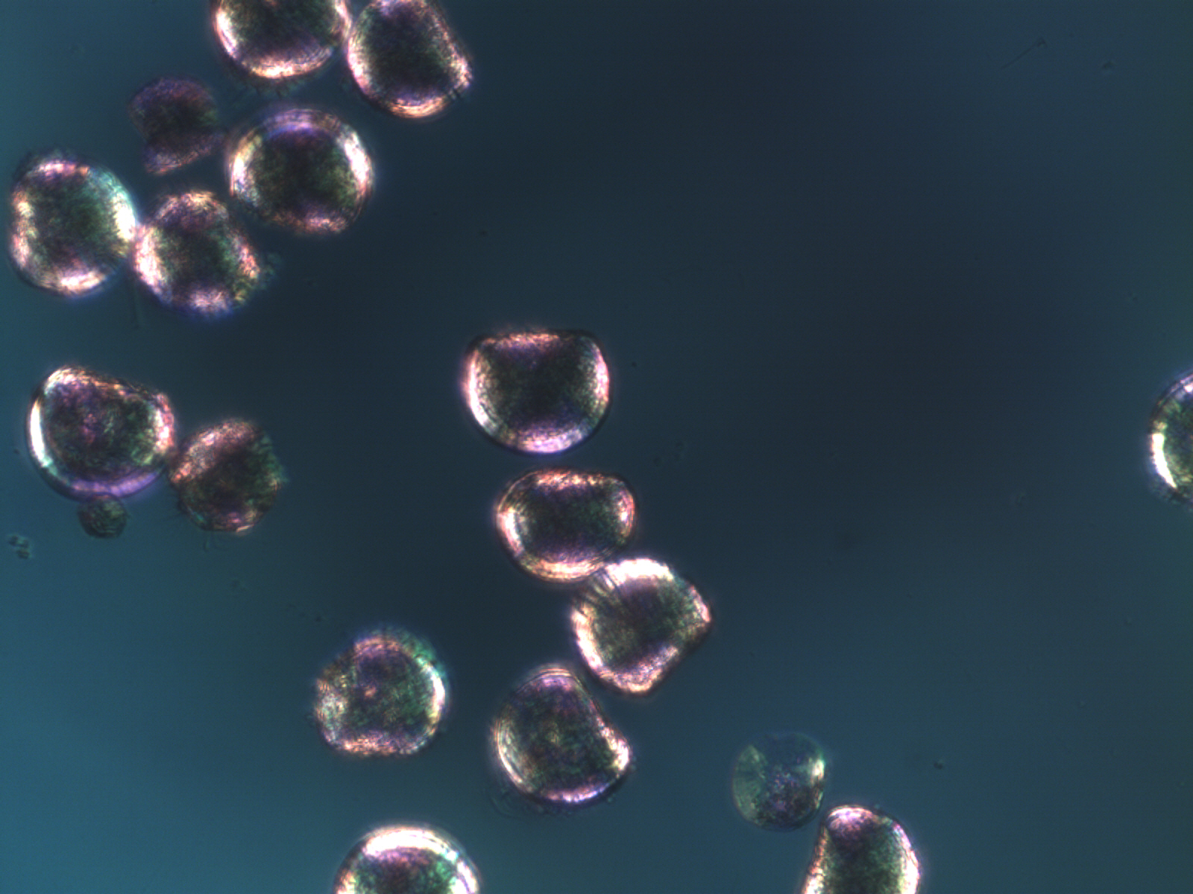
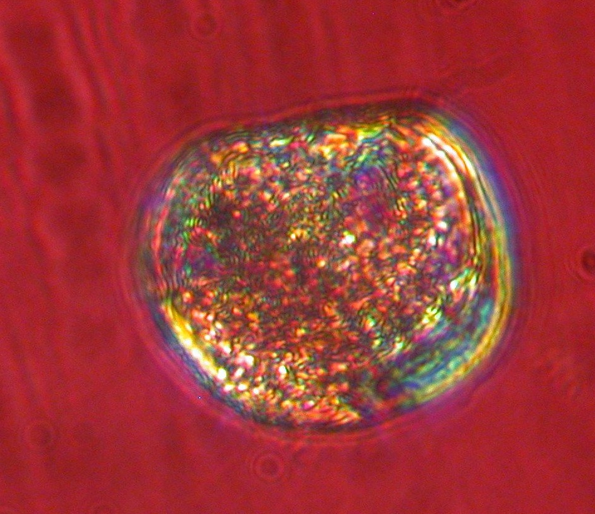
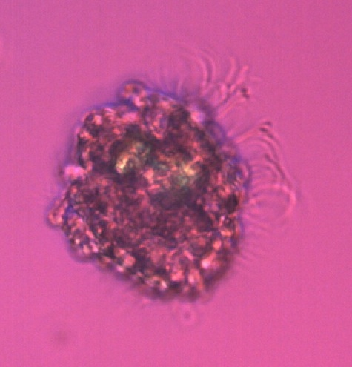
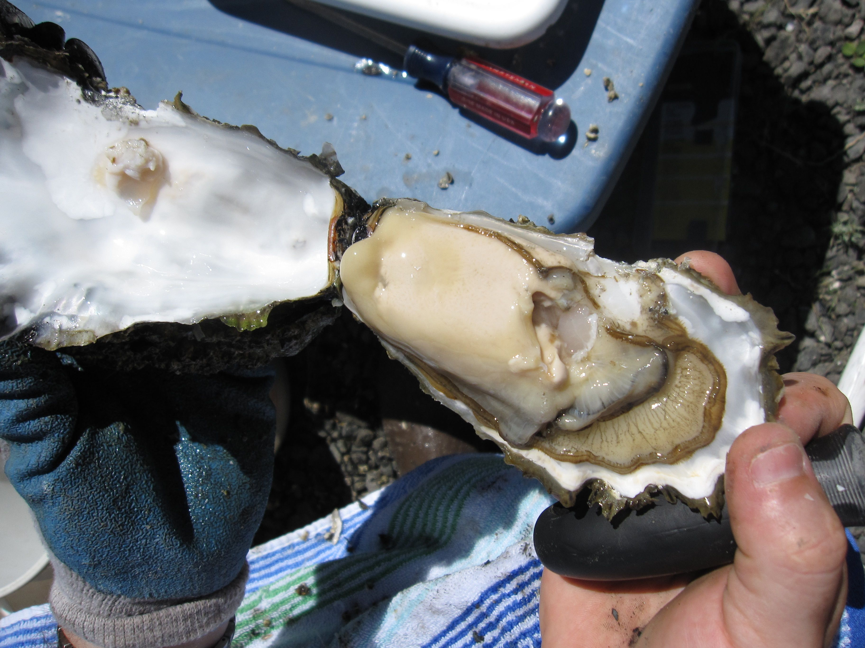
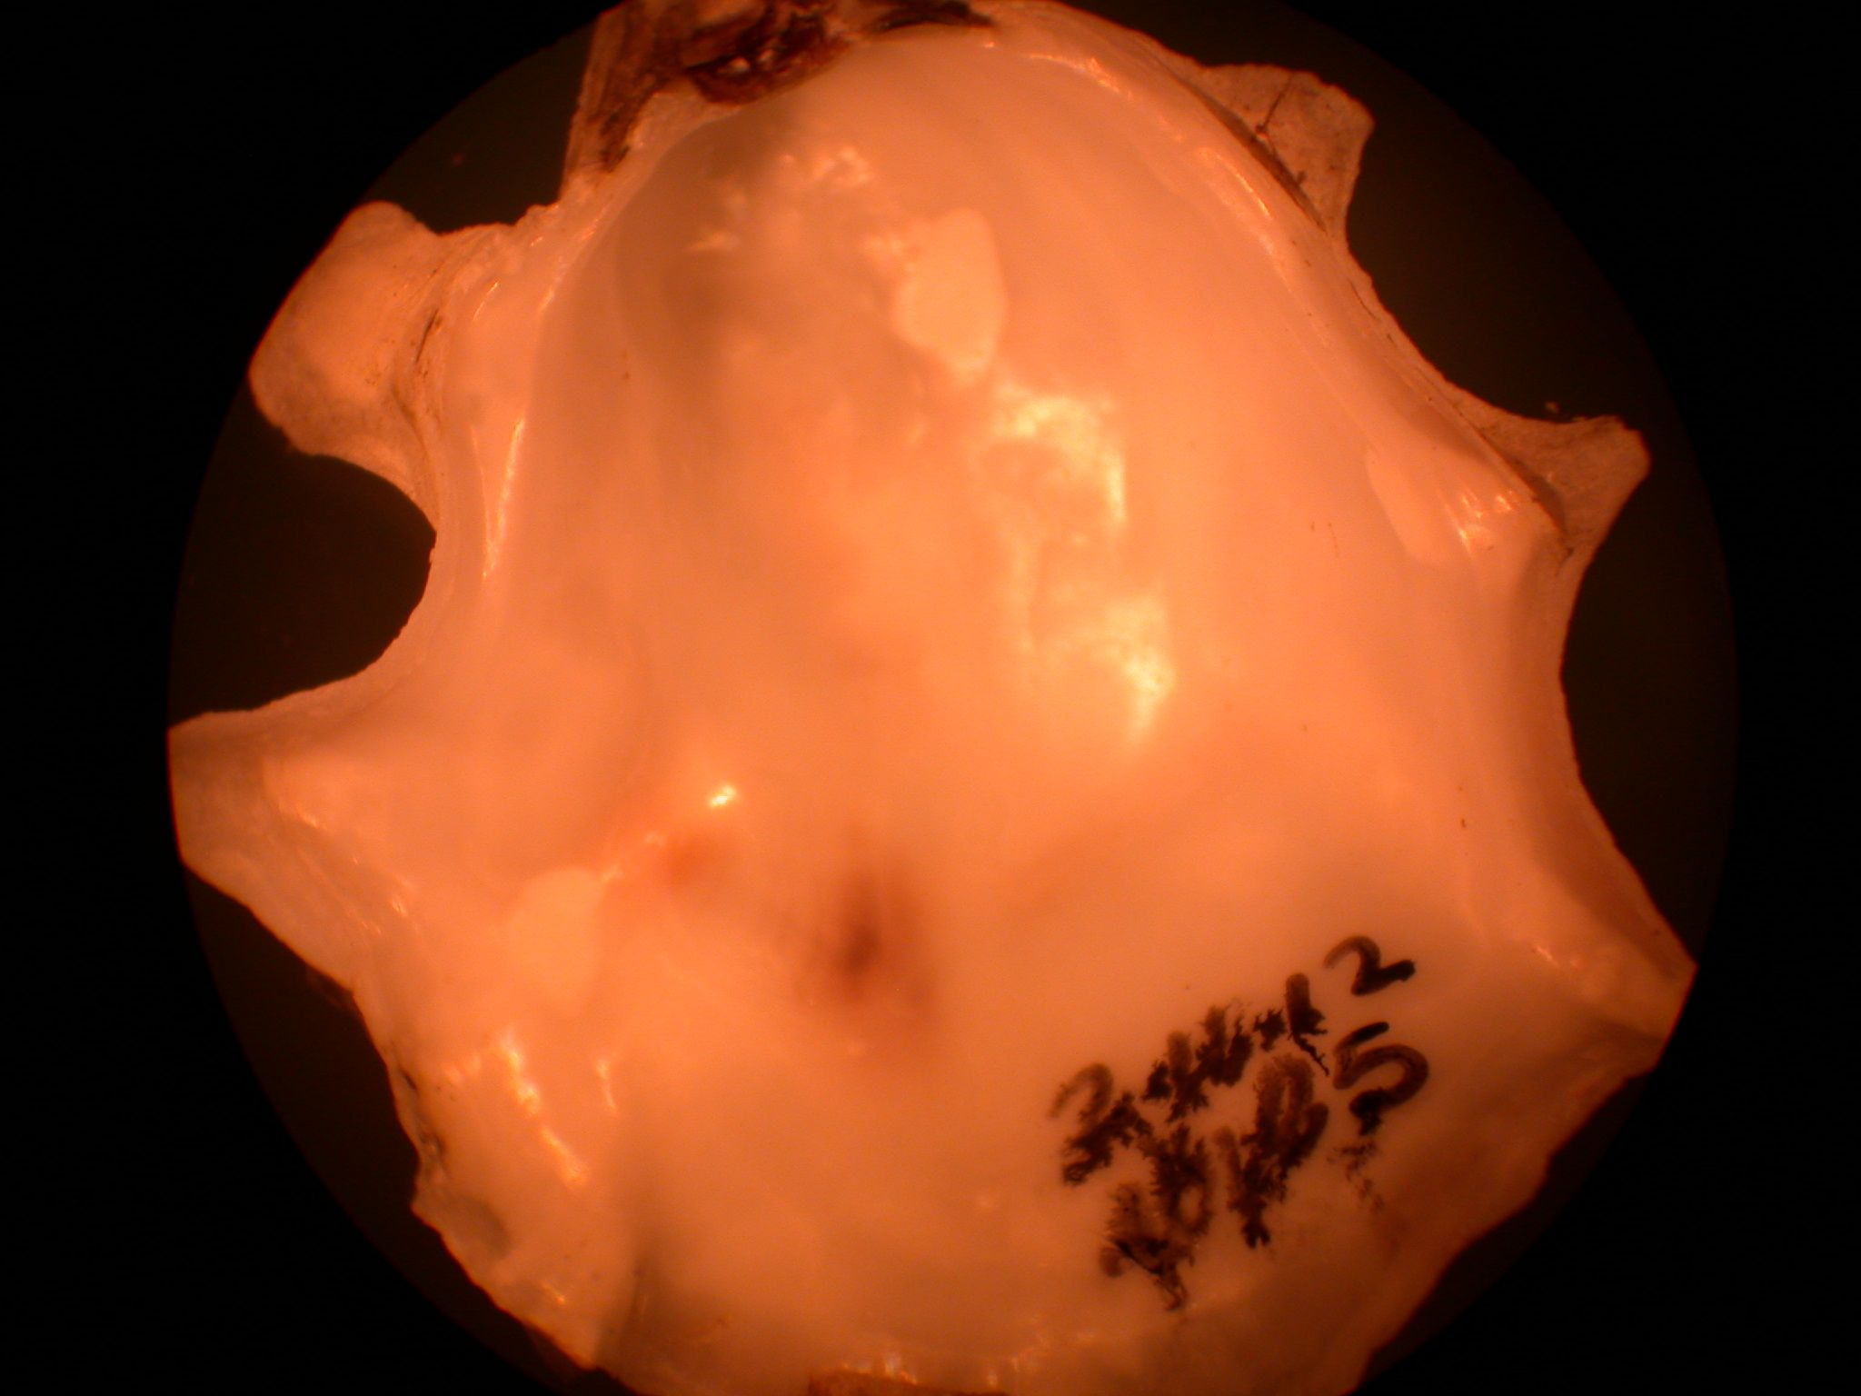
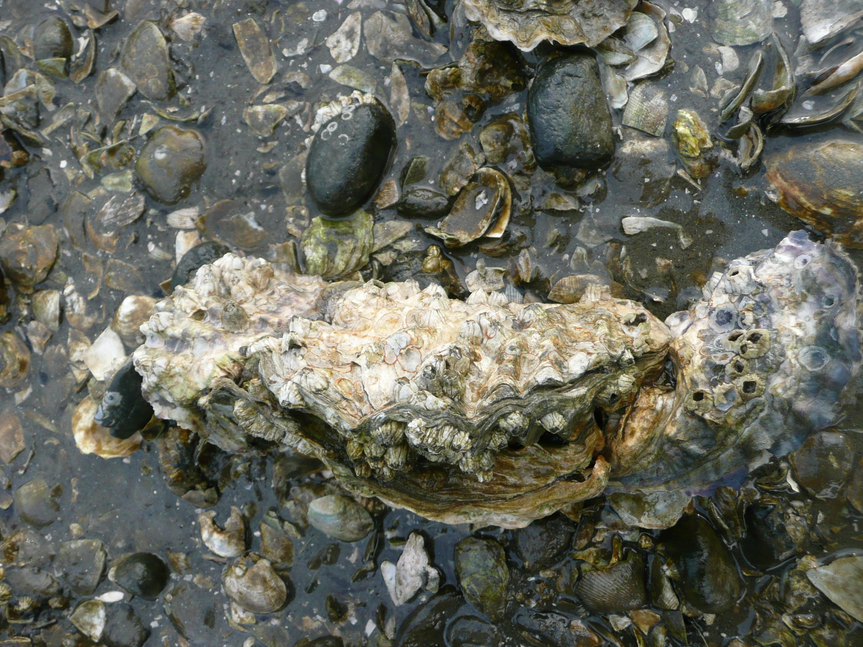
Ocean acidification effects will vary across life stages of the oyster
Notes:
Expect larger reponse on larvae and not as big response in juveniles/adults so want to investigate underlying molecular mechanisms

Slide 4
Larvae
HighCO₂, 1065 µatm, pH 7.66
MidCO₂, pH 7.75
Ambient, pH 7.99

Slide 5
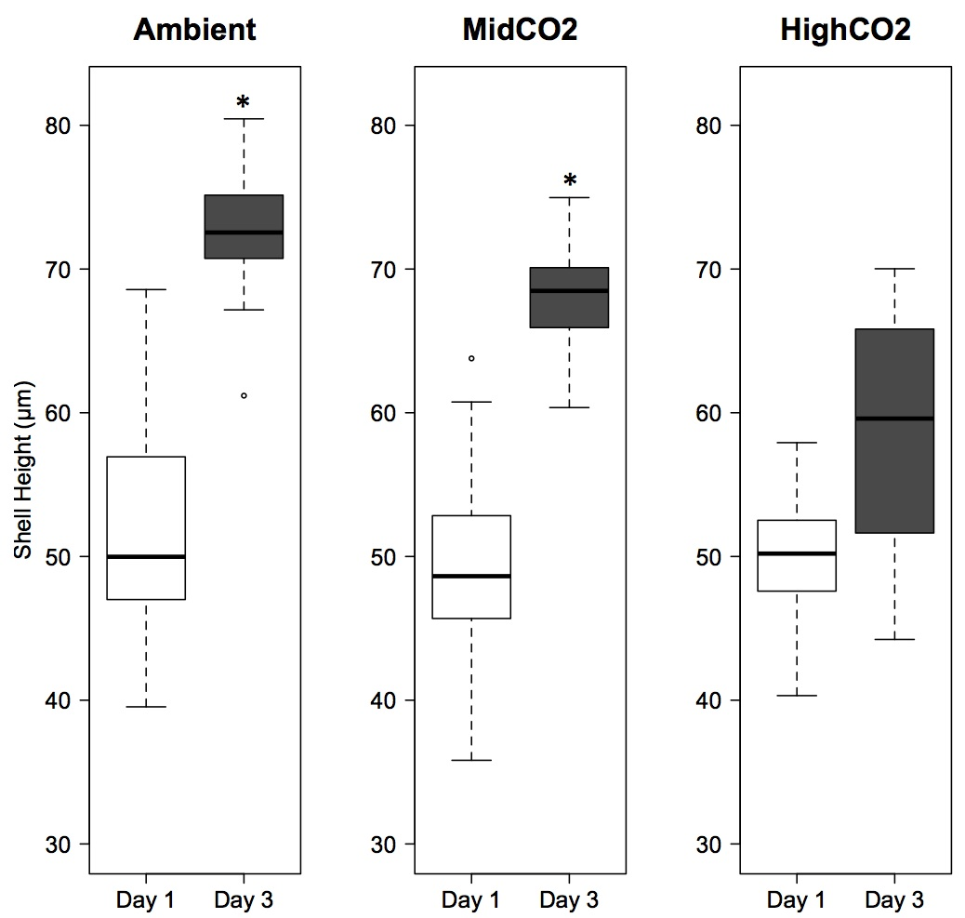
Larvae
Timmins-Schiffman et al. 2013

Slide 6
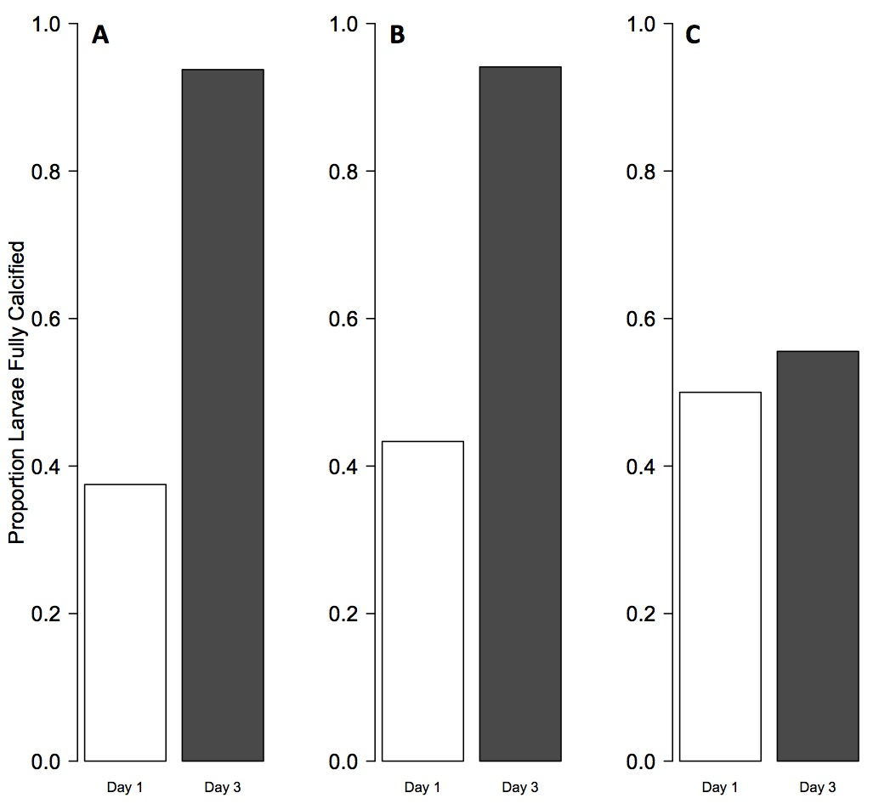
Larvae
Ambient
MidCO₂
HighCO₂
Timmins-Schiffman et al. 2013
Notes:
Smaller size and less calcification was due to developmental delay. Day 1 to 3 corresponds to a shift from dependence on maternal energy resources to external resources – too much stress on energy budget to deal with combatting OA?

Slide 7
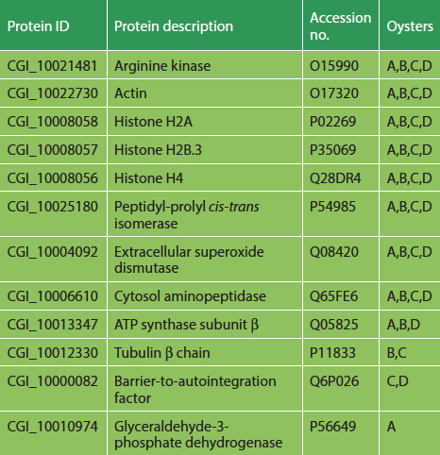
Juveniles: Proteome Characterization
Timmins-Schiffman et al. 2013
Notes:
What are the underlying mechanisms governing the response of juvenile/adult oysters to OA?

Slide 8
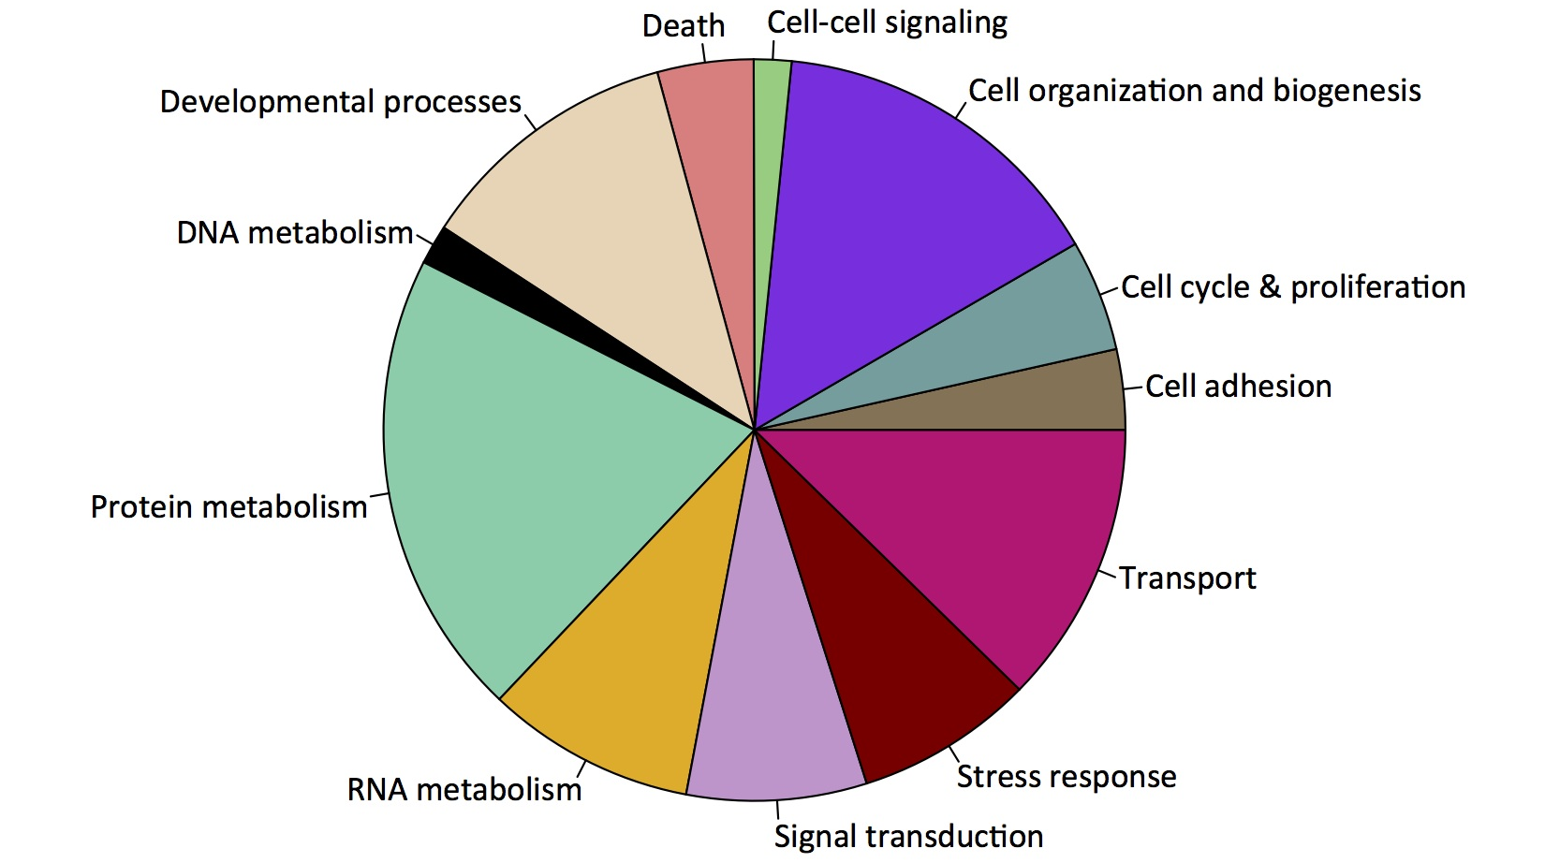
Juveniles: Proteome Characterization
Timmins-Schiffman et al. 2013
Notes:
Gill tissue serves many functions as interface between oyster and environment
Enriched protein categories: generation of precursor metabolites and energy (metabolic processes), oxygen metabolism and reactive oxygen species defense (environmental change)

Slide 9
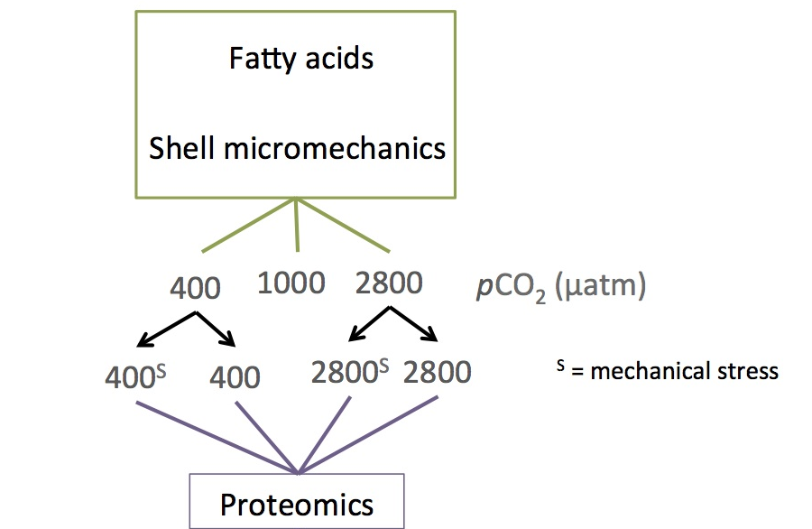
Juveniles: Response to Ocean Acidification
6 pCO₂ treatments for 1 month
Additional stress: heat, mechanical
Samples taken for: proteomics, shell micromechanics, fatty acids, histology, epigenetics

Slide 10
Juveniles: Response to Ocean Acidification
3 pCO₂ treatments for 1 month
Additional stress: mechanical
Samples taken for: proteomics, shell micromechanics, fatty acids (histology, epigenetics)

Slide 11
Proteomic Response to Ocean Acidification
Cortical actin cytoskeleton organization
Cortical cytoskeleton organization
Inflammatory response
Cell-cell junction organization
Response to wounding
Homophilic cell adhesion
Intracellular transport
Maintenance of location in cell
Regulation of transcription, DNA-dependent
Timmins-Schiffman in prep.
Notes:
Immune response is downregulated: inflammatory, wound, homophilic cell adhesion
Transport and transcription are upregulated
Highly, significantly upregulated: calcium-regulated heat stable protein 1 (mRNA binding), thymidine phosphorylase (nucleotide synthesis)

Slide 12
Proteomic Response to Mechanical Stress
tRNA aminoacylation for protein translation
Membrane invagination
Amino acid activation
Cellular membrane organization
Cell proliferation
Endocytosis
Timmins-Schiffman in prep.
Notes:
Highly sig down reg in mech stress: adenylosuccinate lyase (AMP synthesis)
Highly sig up reg in mech stress: nucleolar protein 56 (60S ribosomal subunit biogenesis)

Slide 13
Proteomic Response to OA + Mech Stress
Polysaccharide metabolism
Neurological system process
Regulation of cell proliferation
Mitochondrion organization
Aminoglycan metabolism
Cell activation
Pyrimidine nucleotide metabolism
Homophilic cell adhesion
Protein targeting
Nucleoside metabolism
Maintenance of location in cell
Leukocyte activation
Cellular lipid catabolism
Timmins-Schiffman in prep.
Notes:
Highly upreg mech: NADH dehydrogenase (transfer e- to respiratory chain), dynein heavy chain (cilia), 40S ribosomal protein, cytochrom b (resp chain), cytochrom c oxidase (e- transport), glutahione S-transferase (detoxification), dual oxidase (oxidative stress response)
Downreg: integrin (receptor), thymidine phosphorylase (endothelial cell/blood vessel growth)

Slide 14
Fatty Acid Response to Ocean Acidification
Timmins-Schiffman in prep.

Slide 15
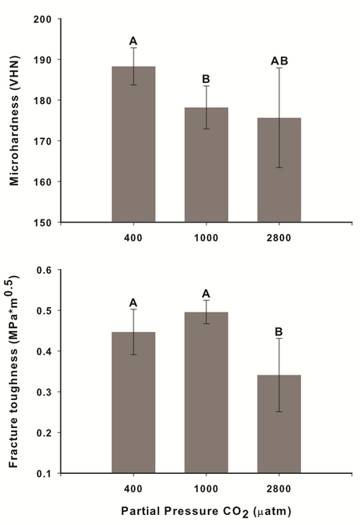
Shell Properties Response to Ocean Acidification
Data from Gary Dickinson
Notes:
All oysters grew throughout experiment

Slide 16
Juveniles: Response to Ocean Acidification
Possible evidence for trade-offs in response to stress
Fatty acid metabolism is not affected
  Lipid catabolism with multiple stressors?
Shell structure is impacted
Heightened response to mechanical stress at 2800 µatm

Slide 17
Proteomics Follow-up: France
Choose 1-2 proteins that are important in response to ocean acidification
Develop protein- and gene-level assays
Characterize expression across developmental stages, tissues, and environmental conditions

Slide 18
Extra! Ceramide Metabolism
Timmins-Schiffman & Roberts 2012
Notes:
23 sequences involved in ceramide metabolism identified, characterized the expression of 4 (bold)
Evidence for conservation of pathway that produces ceramide de novo

Slide 19
Extra! Ceramide Metabolism
Timmins-Schiffman & Roberts 2012
Notes:
3KDSR has conserved catalytic domains across taxonomic groups
Exposure to bacteria prompted increase in ceramide production (3-KDSR) and subsequent transformation into other sphingolipids (AC) – ceramide and sphingolipids are important signaling molecules during stress

Slide 20
Extra! Genomic Resources
Ostrea lurida
Haliotis kamtschatkana
Timmins-Schiffman et al. 2013
Notes:
8641 H. kamtschatkana, 41,136 O. lurida
Large number of genes that did not match those in other species and enriched in environmental stress response – species specific environmental interactions

Slide 21
Extra! Genomic Resources
Ostrea lurida
Haliotis kamtschatkana
Timmins-Schiffman et al. 2013
Notes:
No direct relationship between phylogenetic relatedness and number of shared sequences: incomplete transcriptomes

Slide 22
Timeline
Fall 2009 – start at UW
Winter 2011 – qualifying exam
Fall 2011 – general exam
2012-2013 – papers accepted: larvae, proteome characterization, ceramide, genomic resources
September 2013 – submit juvenile OA response
Sept-Dec 2013 – study in France, write dissertation
January 2014 – finish writing dissertation
January 27, 2014 - defend
Feb-March 2014 - revisions

